Slide 1

Javascript: Bahasa Pemrograman Web
30 August 2023
Matkul: SIG Berbasis Web
Dany Laksono | Dept. Teknik Geodesi UGM

Slide 2

Javascript: Bahasa Pemrograman Web
Client-side dan Server-side Scripting
Javascript, Bahasa Pemrograman Web
Framework dan Library Javascript
Latihan-Latihan

Slide 3


Client-side dan Server-Side Scripting
Dasar Internet dan WebGIS

Slide 4


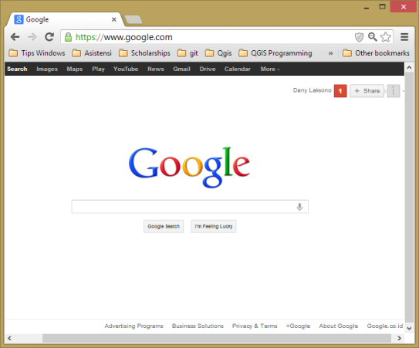



How 'Internet' Works
Server
HTTP REQUEST
HTTP Response
Client

Slide 5
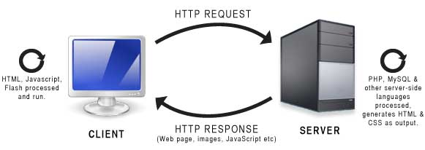
Client-side vs Server-side Scripting

Slide 6
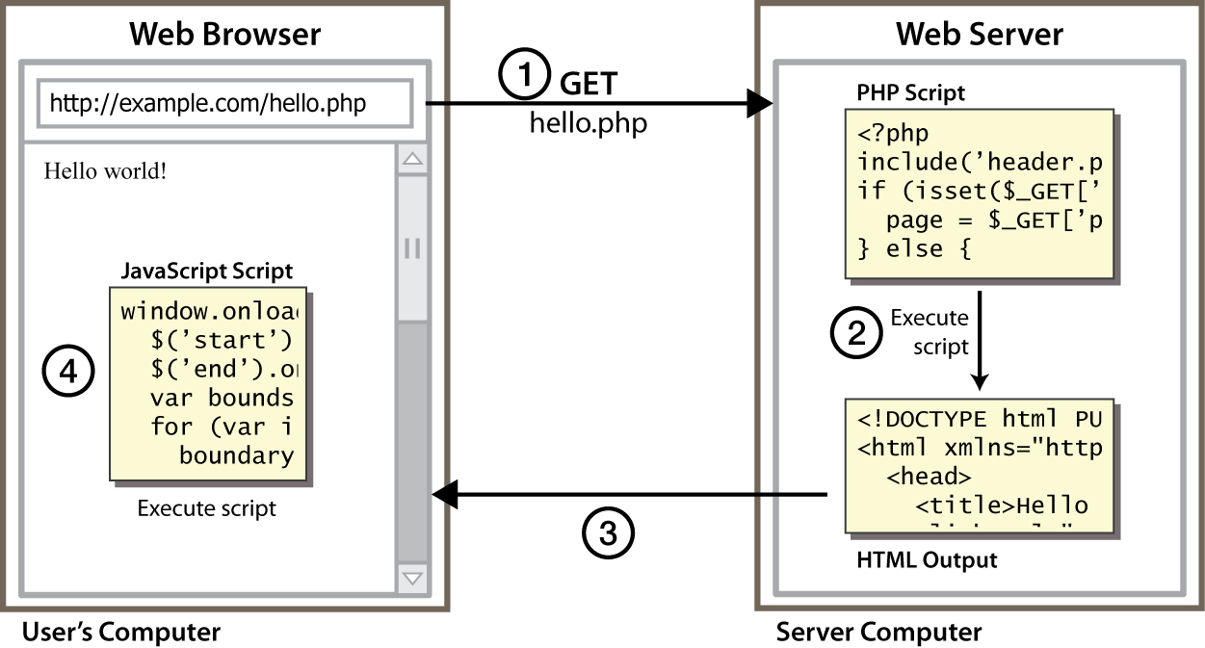
Client-side vs Server-side Scripting

Slide 7
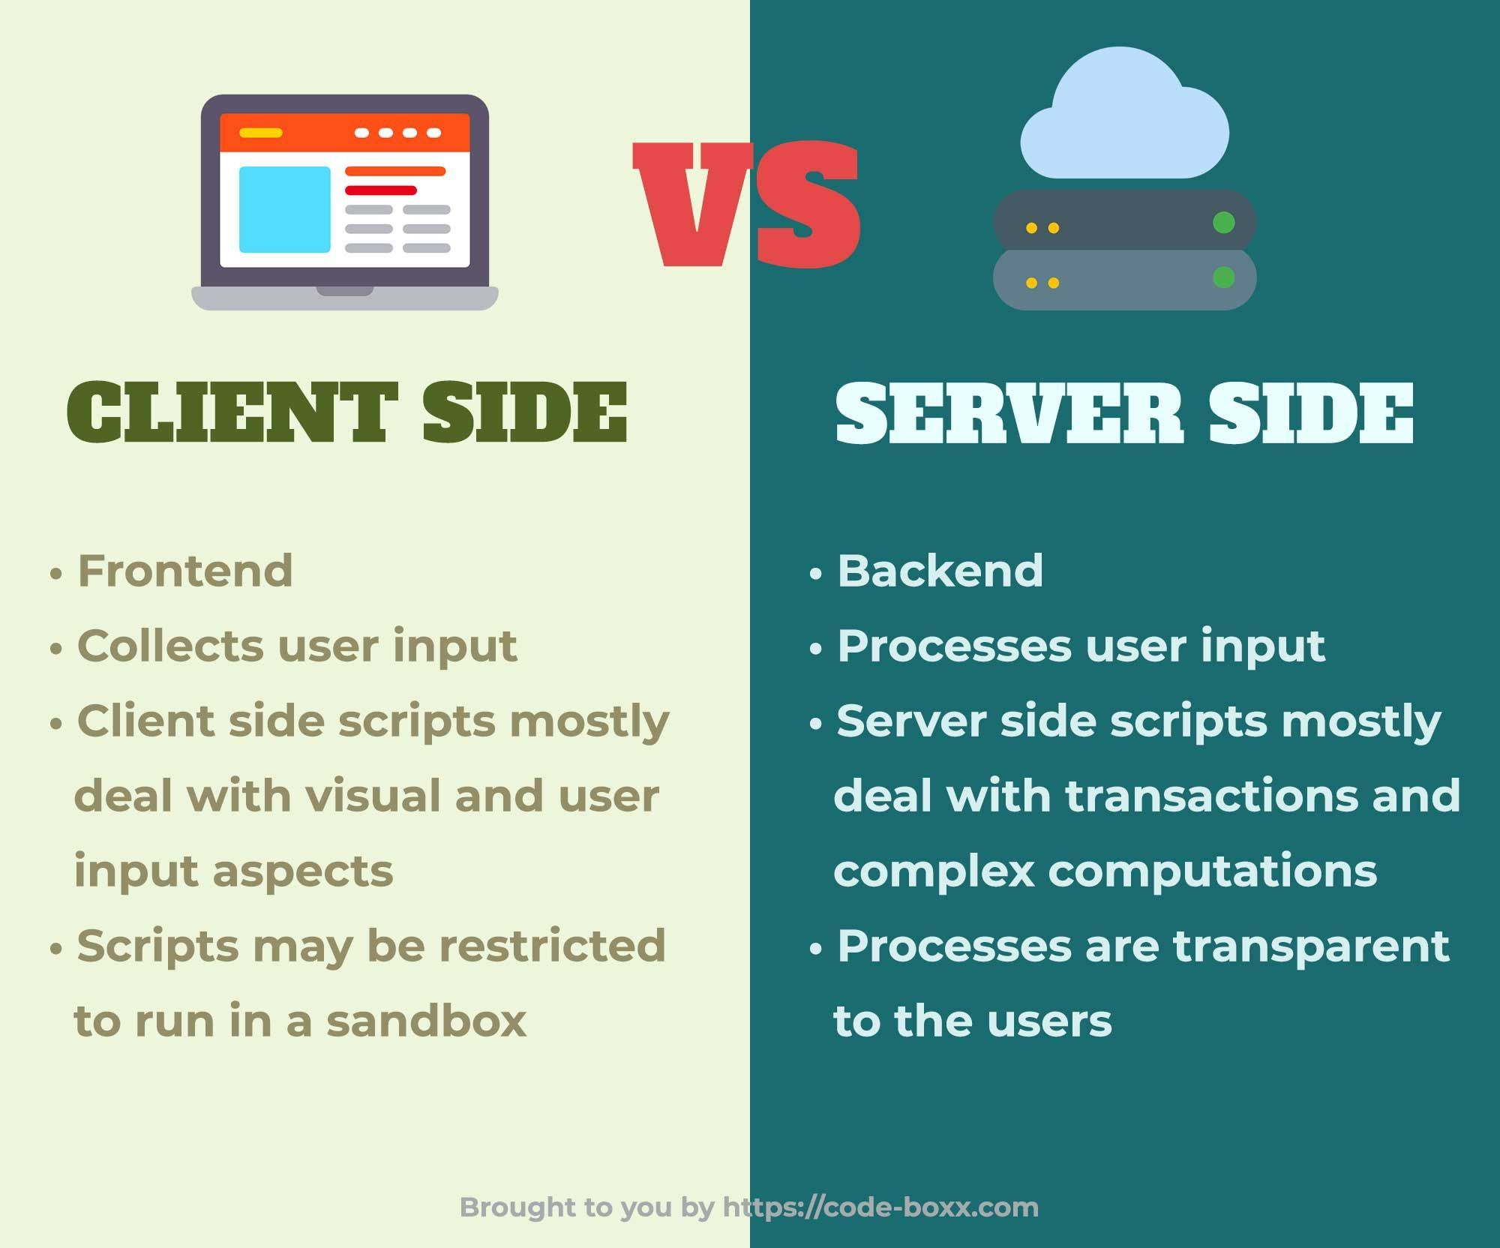
Client-side vs Server-side Scripting
Script “dimasak” di Browser (client)
Script “dimasak” oleh server sebelum disajikan ke Browser

Slide 8
Javascript
Bahasa Pemrograman Web

Slide 9
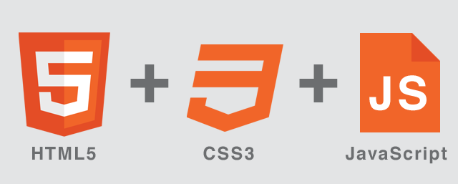
Bahasa Javascript
HTML dan CSS adalah Markup Language, untuk mengatur komponen dan tampilan sebuah halaman Web
Javascript adalah Bahasa pemrograman Web
Notes:
Image sources:
malaymail.com

Slide 10
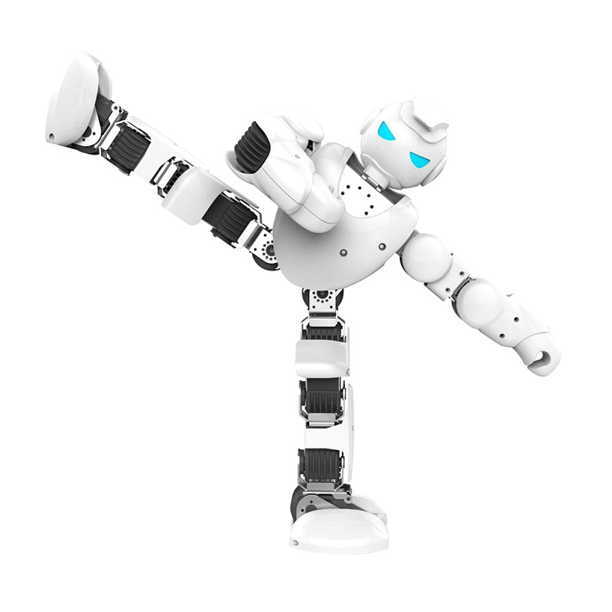
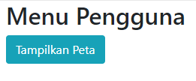
Bahasa Javascript
Bahasa pemrograman memerintahkan bagian tertentu dari robot untuk melakukan suatu aksi, seperti bergerak, berputar, dst.
Misal : di dalam form dikasih tombol submit
Elemen di html harus dibuat dulu sebelum menambahkan action/javascript
Javascript, Bahasa pemrograman web, memerintahkan elemen tertentu (misalnya button) pada halaman web untuk melakukan suatu aksi
Notes:
Image sources:
malaymail.com

Slide 11
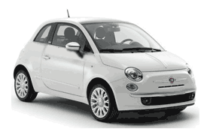
Object, Properties dan Method
Properties : Membantu memberikan styling
Method : Membantu memberikan aksi ke objek/model
Properties are values associated with objects
Methods are actions that objects can perform
Object | Properties | Methods
 | car.name = Fiat car.model = 500 car.weight = 850kg car.color = white | car.start() car.drive() car.brake()
Event is something happens to the object or the environment around it
Event: The car is starting!
Notes:
Image sources:
malaymail.com

Slide 12
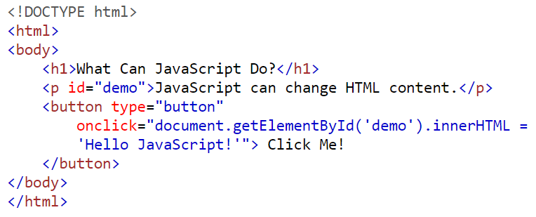
Bahasa Javascript
Javascript dikombinasikan dengan HTML dan CSS untuk menyediakan halaman web yang dinamis dan interaktif
Dapat dikombinasikan dg hmtl dan css dalam satu web
Elemen/paragraf
Tombol, mengambil elemen dengan id demo
Ketika diklik akan muncul ‘hello..’
Notes:
Image sources:
malaymail.com

Slide 13
Bahasa Javascript
HTML dan CSS:
<html>
<body>
<h1 id=“teks” style=“color:blue”> Text ini aslinya warna biru </h1>
…
</body>
</html>
Dikasih id karna biar tau elemennya, shg memudahkan penyusunan java script
Javascript (isikan pada titik-titik di atas):
<script>
document.getElementById("teks").style.color="red";
</script>
Notes:
Image sources:
malaymail.com

Slide 14
Bahasa Javascript
Bagaimana JS dipanggil pada HTML?
 | How? | Examples
1 | External Link | <script src=“peringatan.js” />
2 | Embed in HTML | <script> window.alert(‘peringatan!’); </script>
3 | Inline html tag | <button type="button" onclick="document.getElementById('demo').innerHTML = Date()"> Click me to display Date and Time.</button>
4 | Import from other JS | $.getScript("myscript.js", function(){ alert("Script loaded and executed."); });
Head jg digunakan utk mengambil dr external link
In line HTML
Notes:
Image sources:
malaymail.com

Slide 15
Beberapa konsep Javascript
Expressions
Operators
Numbers and Strings
5 + 6 5 * 10
var x = 5; var y = 6;
10.50 1001
"John Doe" 'John Doe'
(5 + 6) * 10
Defining variables
Comments
var x; x = 6;
var x = 5; // I will be executed // var x = 6; I will NOT be executed
Case Sensitive
/* This is
Multiline comment */
lastName = "Doe"; lastname = "Peterson";
Notes:
Image sources:
malaymail.com

Slide 16
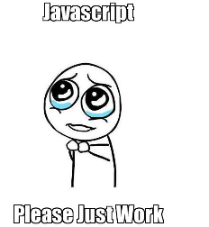
Beberapa konsep Javascript
Datatype
var length = 16; // Number var lastName = "Johnson"; // String var cars = ["Saab", "Volvo", "BMW"]; // Array var x = {firstName:"John", lastName:"Doe"}; // Object
Function
var x = myFunction(4, 3); function myFunction(a, b) { return a * b;
}
Notes:
Image sources:
malaymail.com

Slide 17
Beberapa konsep Javascript
Conditional ‘if’
‘For’ loop
if (hour < 18) { greeting = "Good day"; } else { greeting = "Good evening"; }
for (i = 0; i < cars.length; i++) { text += cars[i] + "<br>"; }
‘do while’ loop
‘while’ loop
do { text += "The number is " + i; i++; } while (i < 10);
while (i < 10) { text += "The number is " + i; i++; }
Notes:
Image sources:
malaymail.com

Slide 18
Beberapa konsep Javascript
Operator | Description
+ | Addition
- | Subtraction
* | Multiplication
/ | Division
% | Modulus
++ | Increment
-- | Decrement
Operator | Example | Same As
= | x = y | x = y
+= | x += y | x = x + y
-= | x -= y | x = x - y
*= | x *= y | x = x * y
/= | x /= y | x = x / y
%= | x %= y | x = x % y
Notes:
Image sources:
malaymail.com

Slide 19

Framework dan Library
Dasar Internet dan WebGIS

Slide 20
Framework dan Libraries
A framework encapsulates common application functionality, allowing the developer to focus on the parts that are unique to their application. Usually that means the developer writes pieces of code that get called by the framework when various things happen; Angular, for example. Libraries are packages of code that typically get called by your application to perform a task, like DOM manipulation or HTTP requests; ThreeJS, for example.
Frameowrk : cakupannya lebih luas drpd libraries. Dia lebih lengkap. Contohnya bootstrep
Libraries : threejs
Notes:
Image sources:
malaymail.com

Slide 21
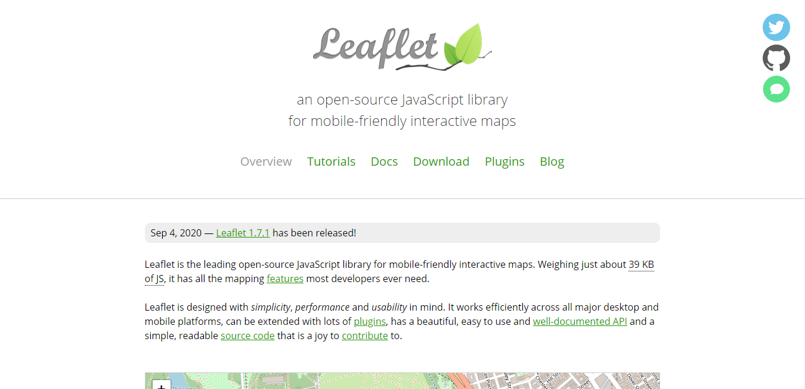

Slide 22
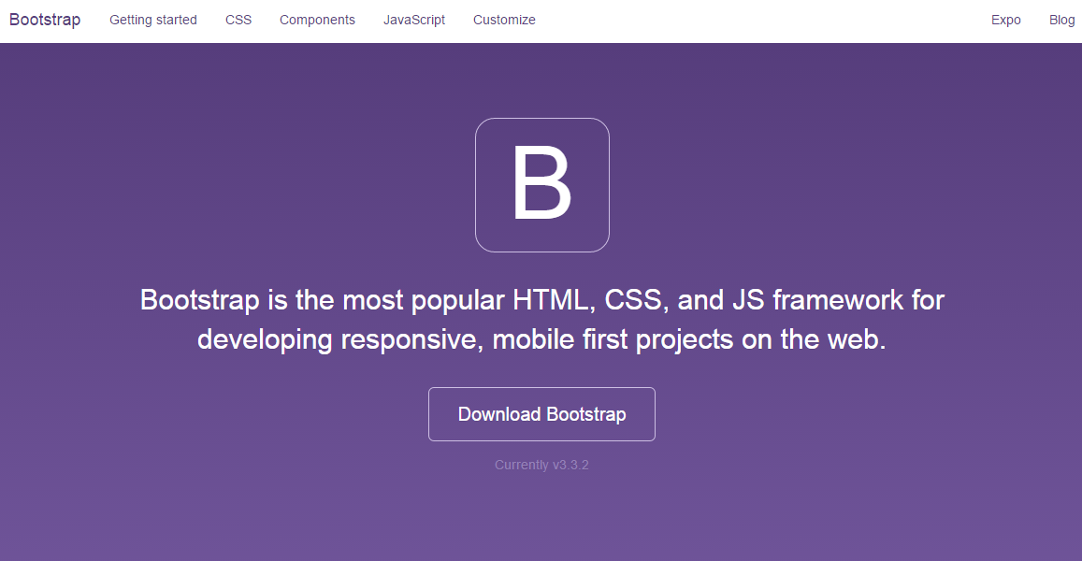

Slide 23
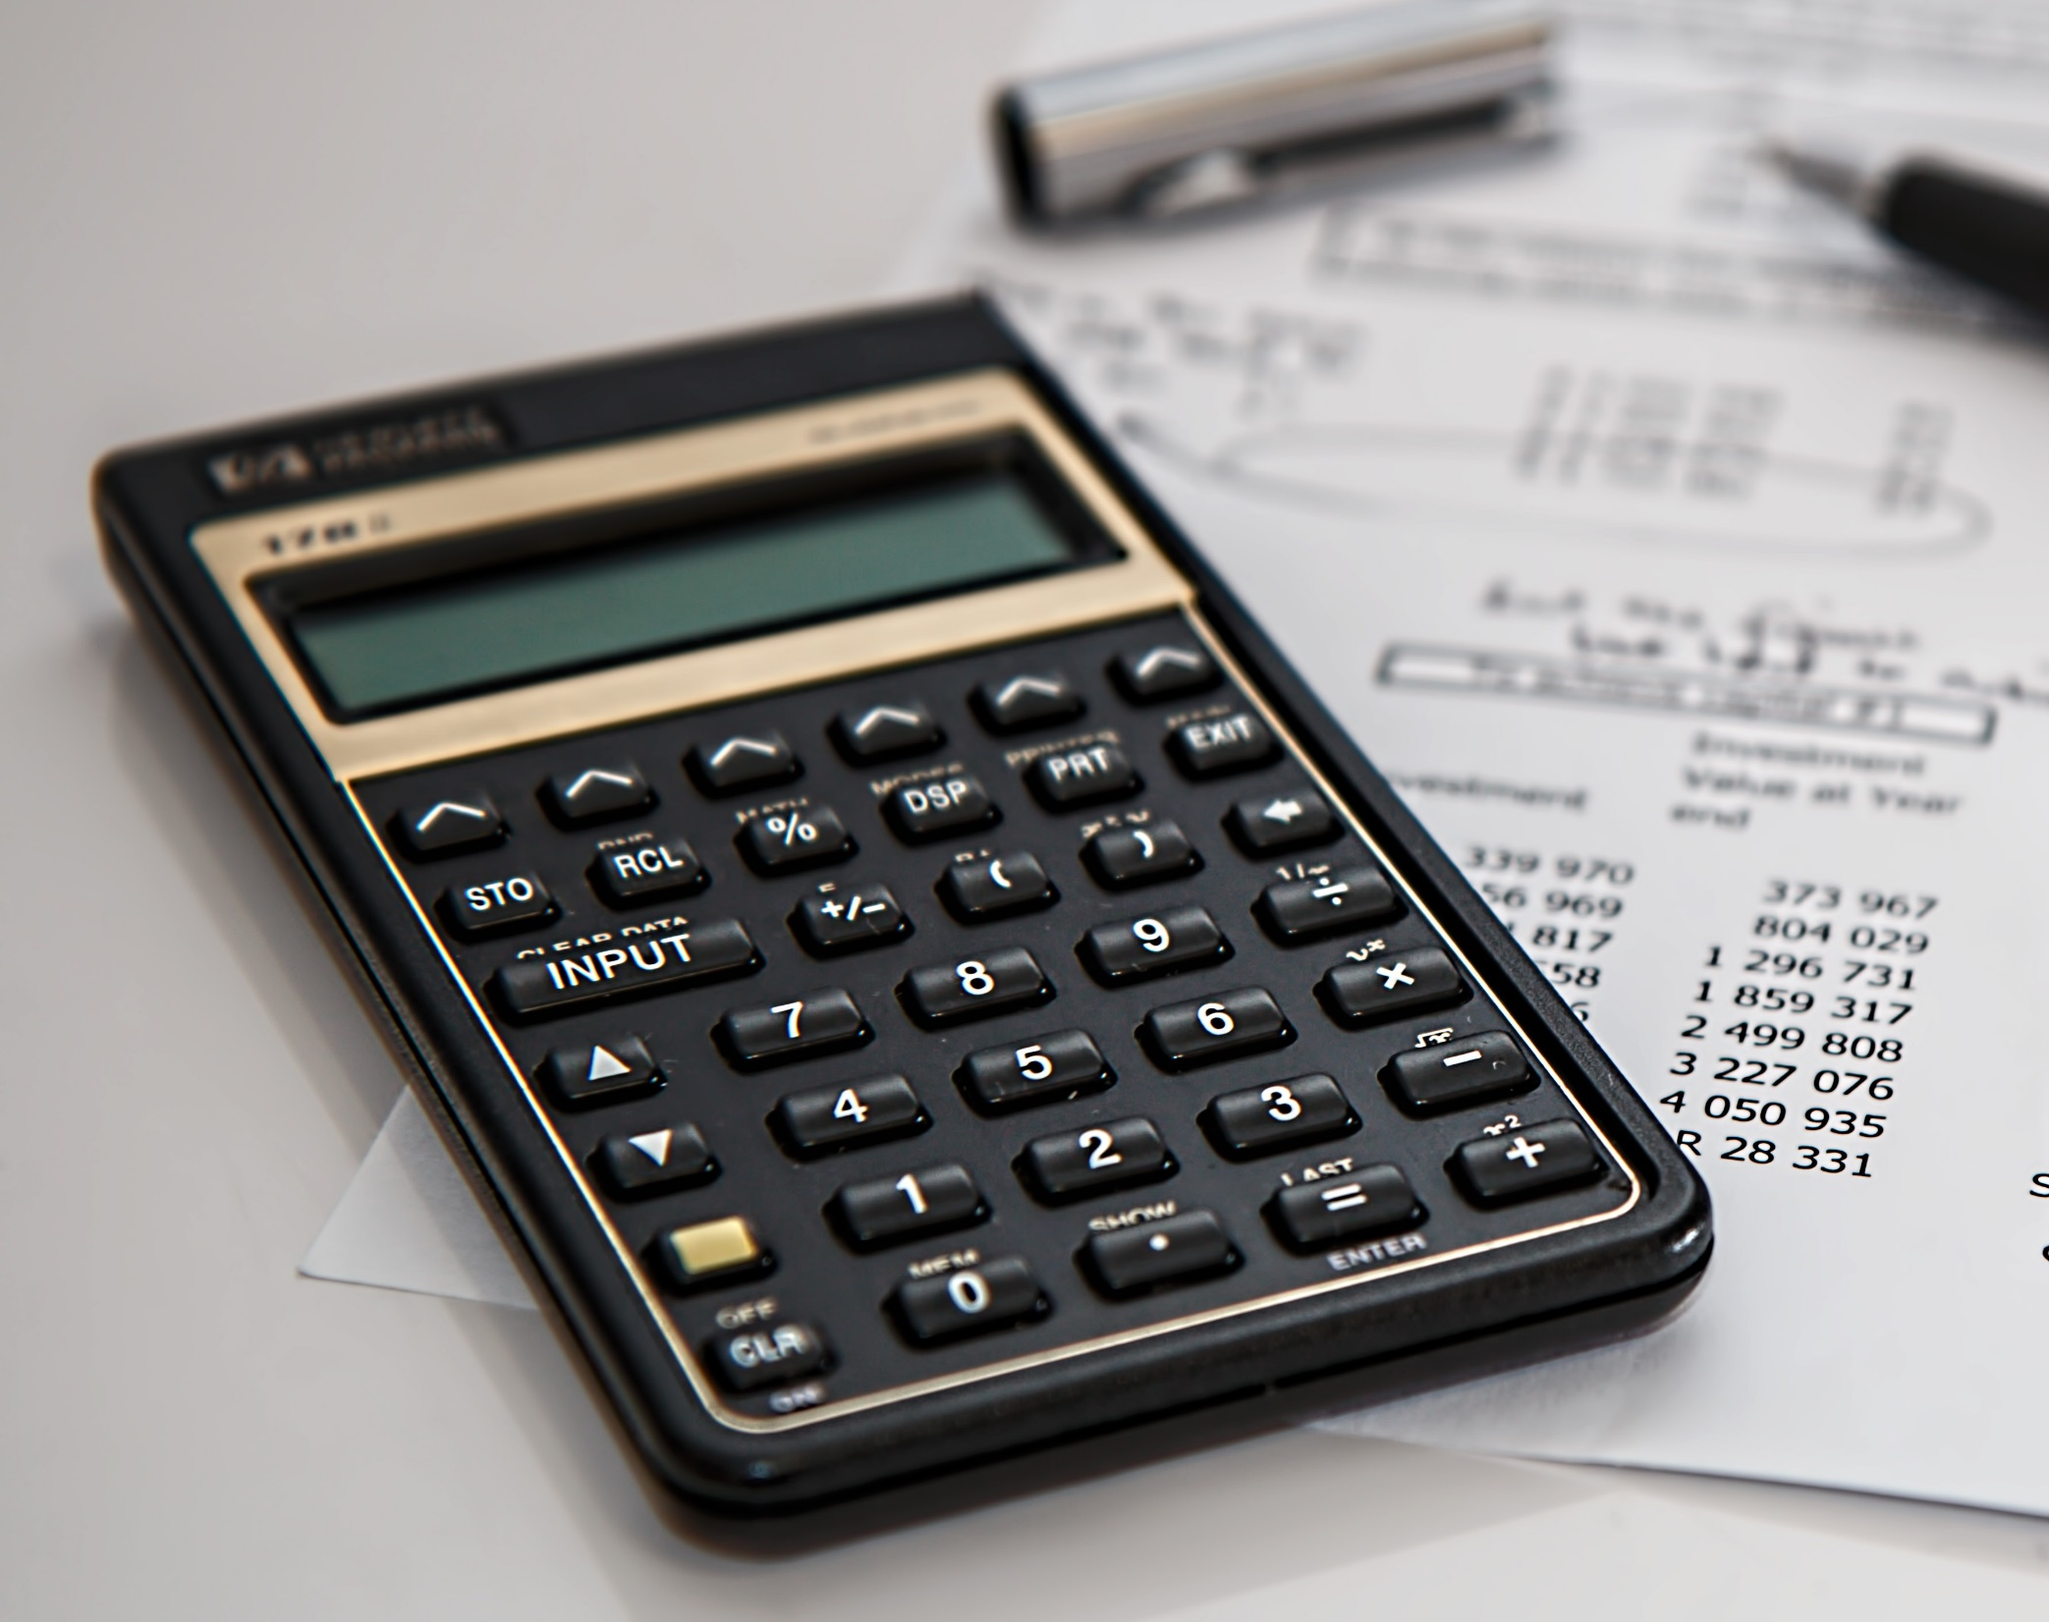
Latihan-latihan
Javascript Bahasa Pemrograman Web

Slide 24
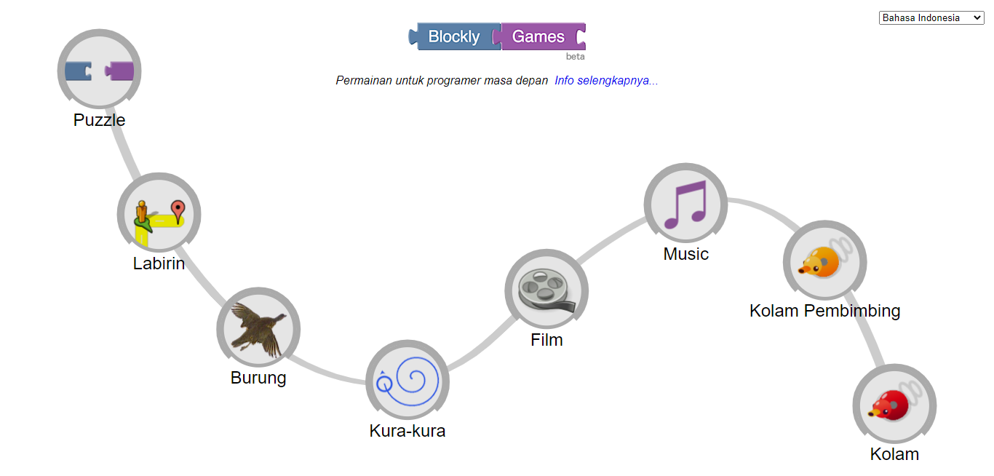
Game ON!
https://blockly.games/
Notes:
Image sources:
malaymail.com

Slide 25
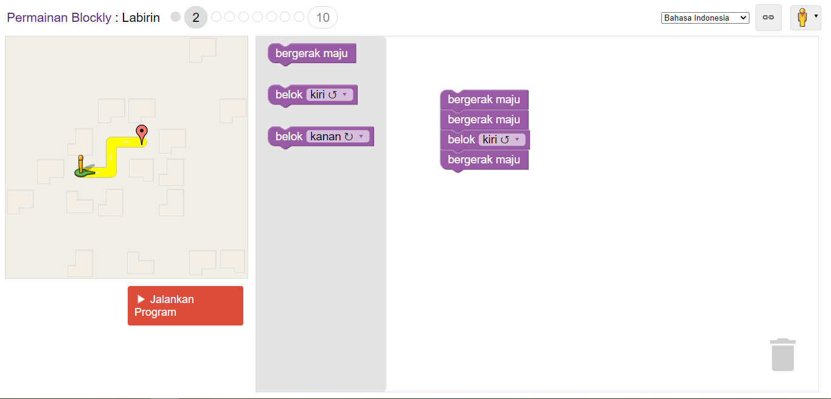
Gunakan pilihan langkah yang tersedia untuk menyusun algoritma dan menyelesaikan permainan

Slide 26
Programming is not about memorizing scripts,
Instead, it’s a logic’s work to craft algorithms to solve problems

Slide 27

TERIMA KASIH

